Slide 1
Java SE 17 – Presentation
Chapter 9 – Collections and Generics

Slide 2
Revision
- Collections is a set of ...
– ... is a framework ...
There are ... main type of ... we will study ...
+)
+)
+) ... is a special collections ... in certain order ... Deque is ... access
+)
- Map doesnt implement Collections because ... It requires special ...

Slide 3
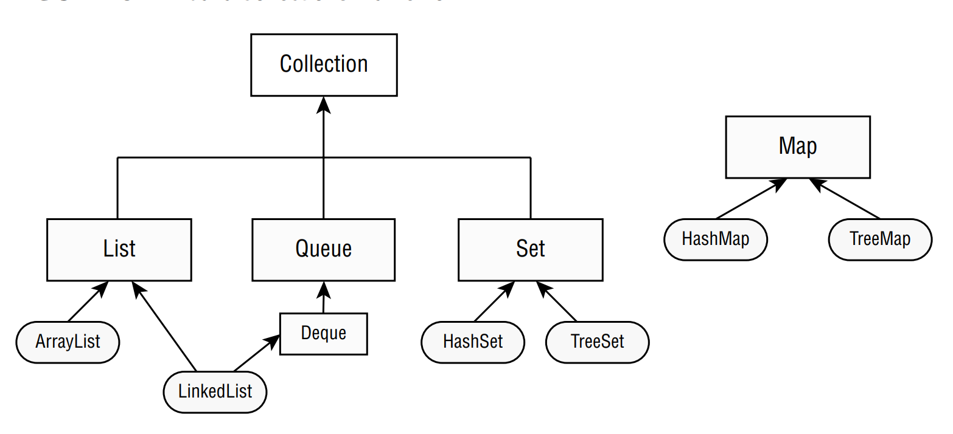
Revision
- In the next section we will ... method ... ArrayList and HashSet ...
Using the diamond operator
- Note: We can ..., but if we use it ... we must ...
Adding data add()
Removing data()
- Note: ArrayList has ... versions => We must be careful when ...

Slide 4
Revision
Counting elements
isEmpty()
size()
Clearing the Collections
clear()
Check Contents
contains()
Removing with conditions
removeIf() will ... all ... if condition is .... This method has a ... as a parameter (we will explain the <? super E> later)
(code illustration snippet 1,2)

Slide 5
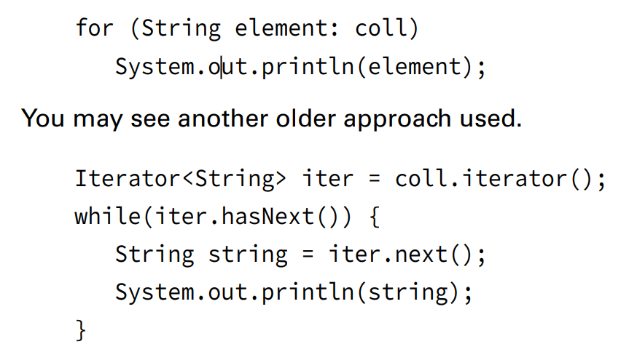
Revision
Iterating
- forEach() is used to .... It recieves a ... as a parameter ...
(code illustration snippet 3)
Determining Equality
the method equals() also has own ... for each ... (e.g ArrayList check ... while HashSet ...)
(code illustration snippet 4)
- Although Java protected us from ... we still ... (code illustration snippet 5)

